Slide 1



MICROCONTROLLER BASED SYSTEM DESIGN
CSE 3215
Lecture 9

Slide 2
Sensor
A sensor is a device that detects and responds to some type of input from the physical environment.
The specific input could be light, heat, motion, moisture, pressure, or any one of a great number of other environmental phenomena.
The output is generally a signal that is converted to human-readable display at the sensor location or transmitted electronically over a network for reading or further processing.

Slide 3
Sensor
A sensor is a device which detects one form of energy and converts the data to electrical energy. For example, microphone.

Slide 4
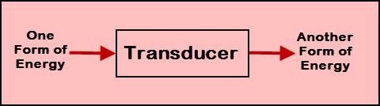
Transducer
The transducer can be defined as a device which is used for converting one form of energy into another form.
In general, transducers deal with different energy types such as electrical energy, mechanical energy, chemical energy, light energy, electromagnetic energy, thermal energy, acoustic energy, and so on.

Slide 5
Transducer
For example, consider mic (mic of telephone or mobile phone or audio set mic) we use in our day-to-day life converts the audio signals into electrical signals and then amplifies it into the desired range (depends on system and settings of the user).
Then, converts the electrical signals into audio signals at the output of the speakers or loudspeaker.
The fluorescent bulbs we use for lighting, converts the electrical energy into light energy.
The mic, speaker, and fluorescent bulb can be considered as transducers. Similarly, there are different types of transducers used in practical applications.

Slide 6
Actuator
An actuator is a device that is responsible for moving or controlling a mechanism or system. It is controlled by a signal from a control system or manual control. It is operated by a source of energy, which can be mechanical force, electrical current, hydraulic fluid pressure and converts that energy into motion.
An actuator is the mechanism by which a control system acts upon an environment. The control system can be simple (a fixed mechanical or electronic system), software-based (e.g. a printer driver, robot control system), a human, or any other input.

Slide 7
Examples of Sensors and Transducers
Medium | Input Device (Sensor) | Output Device (Actuator)
Light Device | Light Dependent Resistor (LDR), Photodiode, Photo-Transistor, Solar Cell | Lights & Lamps, LED, Displays, Fiber Optics
Temperature | Thermocouple, Thermistor, Thermostat, Resistive Temperature Detectors | Heater, Fan

Slide 8
Passive and active sensors
Passive sensors require an external power source to operate, which is called an excitation signal. The signal is modulated by the sensor to produce an output signal.
For example, a thermistor does not generate any electrical signal, but by passing an electric current through it, its resistance can be measured by detecting variations in the current or voltage across the thermistor.

Slide 9
Passive and active sensors
Active sensors are those which do not require any power source for their operation. They work on the energy conversion principle. They produce an electrical signal proportional to the input (physical quantity). For example, a thermocouple is an active sensor.

Slide 10
Characteristics of Sensors
Range: It is the minimum and maximum value of physical variable that the sensor can sense or measure. For example, a Resistance Temperature Detector(RTD) for the measurement of temperature has a range of -200 to 800ºC.
Span: It is the difference between the maximum and minimum values of input. In above example, the span of RTD is 800 - (-200)
= 1000ºC.

Slide 11

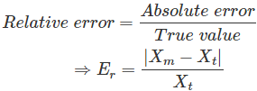
Characteristics of Sensors
Accuracy: The error in measurement is specified in terms of accuracy. It is defined as the difference between measured value and true value. It is defined in terms of % of full scale or % of reading.
X_{t} is calculated by taking mean of infinite number of measurements.

Slide 12
Characteristics of Sensors
Precision: It is defined as the closeness among a set of values. It is different from accuracy. Let X_{t} be the true value of the variable X and a random experiment measures X₁, X₂, …. X_{i} as the value of X. We will say our measurements X₁, X₂,… X_{i} are precise when they are very near to each other but not necessarily close to true value X_{t}. However, if we say X₁, X₂,… X_{i} are accurate, it means that they are close to true value X_{t} and hence they are also close to each other. Hence accurate measurements are always precise.

Slide 13
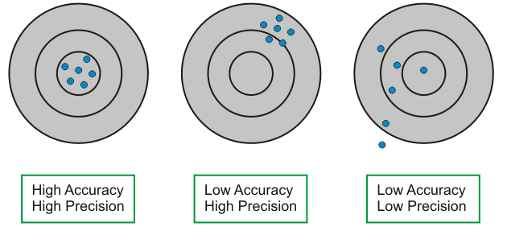
Characteristics of Sensors

Slide 14

Characteristics of Sensors
Sensitivity: It is the ratio of change in output to change in input. If Y be the output quantity in response to input X, then sensitivity S can be expressed as
Dead band :The dead band or dead space of a transducer is the range of input values for which there is no output.

Slide 15
Characteristics of Sensors
Resolution: It is the minimum change in input that can be sensed by the sensor.
Reproducibility: It is defined as the ability of sensor to produce the same output when same input is applied.
Linearity-Nonlinearity : Input values or output values lie on a straight line or not.
Response Time: It is generally expressed as the time at which the output reaches a certain percentage (for instance, 95%) of its final value, in response to a step change of the input.

Slide 16
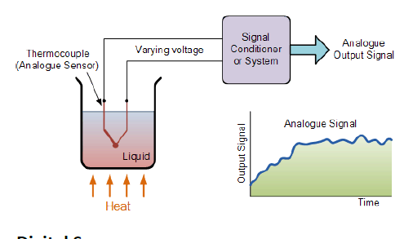
Analogue Sensors
Analogue Sensors produce a continuous output signal or voltage which is generally proportional to the quantity being measured. For
example, the temperature of a
be measured using a
liquid can
thermometer or thermocouple which continuously responds to temperature changes as the liquid is heated up or cooled down.

Slide 17
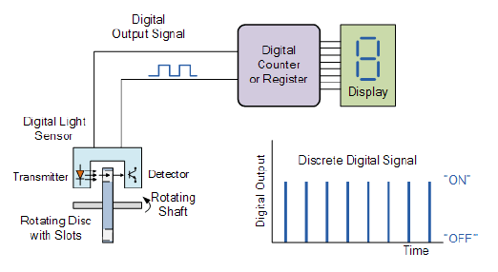
Digital Sensors
Digital Sensors produce a discrete digital output signals or voltages that are a digital representation of the quantity being measured. Digital sensors produce a Binary output signal in the form of a logic “1” or a logic “0”, (“ON” or “OFF”).

Slide 18
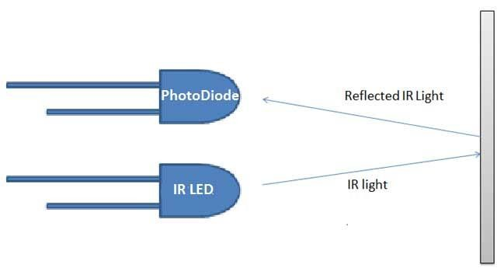
IR Sensor
An Infrared (IR) sensor is used to detect obstacles in front or to differentiate between colors depending on the configuration of the sensor.
The sensor emits IR light and gives a signal when it detects the reflected light.
The circuit required to make an IR sensor consists of two parts; the emitter circuit and the receiver circuit.

Slide 19
IR Sensor
The emitter is simply an IR LED (Light Emitting Diode) and the detector is simply an IR photodiode which is sensitive to IR light of the same wavelength as that emitted by the IR LED.
When IR light falls on the photodiode, its resistance and correspondingly, its output voltage, change in proportion to the magnitude of the IR light received. This is the working principle of an IR sensor.

Slide 20
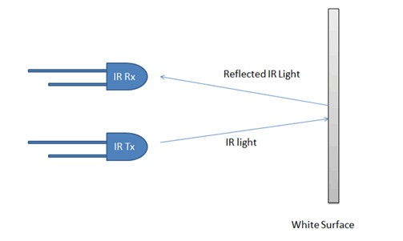
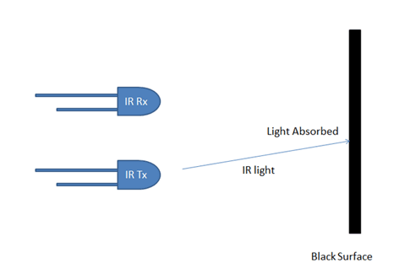
IR Sensor

Slide 21
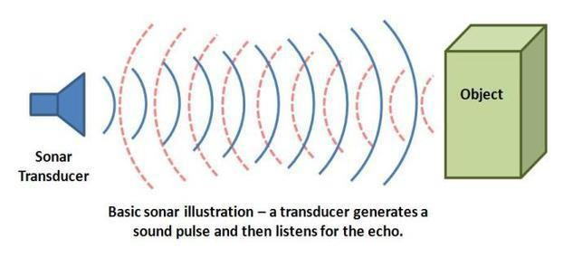
Sonar Sensor
An Ultrasonic sensor is a device that can measure the distance to an object by using sound waves. It measures distance by sending out a sound wave at a specific frequency and listening for that sound wave to bounce back. By recording the elapsed time between the sound wave being generated and the sound wave bouncing back, it is possible to calculate the distance between the sonar sensor and the object.

Slide 22
Sonar Sensor
Since it is known that sound travels through air at about 344 m/s (1129 ft/s), you can take the time for the sound wave to return and multiply it by 344 meters (or 1129 feet) to find the total round-trip distance of the sound wave.
Round-trip means that the sound wave traveled 2 times the distance to the object before it was detected by the sensor; it includes the 'trip' from the sonar sensor to the object AND the 'trip' from the object to the Ultrasonic sensor (after the sound wave bounced off the object).

Slide 23

Sonar Sensor
To find the distance to the object, simply divide the round-trip
distance in half.

Slide 24
Resistance Temperature Detector (RTD)
A Resistance Thermometer or Resistance Temperature Detector is a device which used to determine the temperature by measuring the resistance of pure electrical wire. This wire is referred to as a temperature sensor.
The RTD wire is a pure material, typically platinum, nickel, or copper.
The material has an accurate resistance/temperature relationship which is used to provide an indication of temperature.
As RTD elements are fragile, they are often housed in protective
probes.

Slide 25

Resistance Temperature Detector (RTD)
The variation of resistance of a wire with temperature can be represented by following equation:
Where,
R0 = Resistance at temperature T0 Rt = Resistance at temperature Tt
α = Temperature coefficient of the material

Slide 26


Resistance Temperature Detector (RTD)
The temperature coefficient of resistance is denoted by given in units of Ω:
and is usually
Where,
R₀ is the resistance of the sensor at 0 °C R₁₀₀ is the resistance of the sensor at 100 °C

Slide 27
Temperature Sensor (LM-35)
The LM35 is an integrated sensor circuit that can be used to measure
temperature with an electrical output proportional to the
temperature (in ⁰C)
Measures temperature more accurately than a using a thermistor.
The sensor circuitry is sealed and not subject to oxidation.
The LM35 generates a higher output voltage than thermocouples and may not require that the output voltage be amplified.

Slide 28
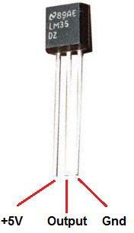
Temperature Sensor (LM-35)
LM-35 Features
It has an output voltage that is proportional to the Celsius temperature.
The scale factor is .01V/⁰C
The LM-35 does not require any external calibration or trimming and maintains an accuracy of ±0.4⁰C at room temperature and ±0.8⁰C over a range of 0⁰C to 100⁰C.
Another important characteristic of the LM-35 is that it draws only 60 micro amps from its supply and possesses a low self-heating capability. The sensor self-heating causes less than 0.1⁰C temperature rise in still air.

Slide 29
Light Sensor
A photoresistor (or light-dependent resistor, LDR) is a light-controlled variable resistor.
The resistance of a photoresistor decreases with increasing incident light intensity;
In other words, it exhibits photoconductivity.
In the dark, a photoresistor can have a resistance as high as several megohms (MΩ), while in the light, a photoresistor can have a resistance as low as a few hundred ohms.

Slide 30
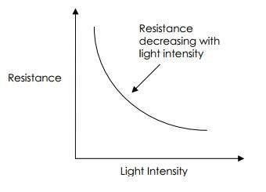
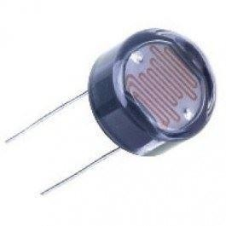
Light Sensor
A typical LDR
Typical LDR resistance vs light intensity graph

Slide 31
Light Sensor
Applications of LDRs
Lighting switch
The most obvious application for an LDR is to automatically turn on a light at a certain light level. An example of this could be a street light or a garden light.
Camera shutter control
LDRs can be used to control the shutter speed on a camera. The LDR would be used to measure the light intensity which then adjusts the camera shutter speed to the appropriate level.

Slide 32
Photoconductivity
Photoconductivity is an optical and electrical phenomenon in which a material becomes more electrically conductive due to the absorption of electromagnetic radiation such as visible light, ultraviolet light, infrared light, or gamma radiation.

Slide 33

THANK YOU

